Slide 1
The Congo Red Test A Novel Approach to Reducing Morbidity and Mortality from Preeclampsia in Clinical Context
Part I:
Clinical Context of Preeclampsia &
Science Behind the Congo Red Point-of-Care Test
Part II:
Operational Feasibility Study in Ethiopia and Uganda

Slide 2
PART I
Clinical Context of Preeclampsia
&
Science Behind the Congo Red Point-of-Care Test

Slide 3
Disclosures & Acknowledgements
Concepts presented today are subject of patents on which I am listed as inventor.
Some of the IP has been licensed to private for profit entities for development & commercialization. I have a consulting role.
Funding: NIH/NICHD, USAID, Bill & Melinda Gates Foundation and the other the Saving Lives at Birth (SLaB) partners

Slide 4
Preeclampsia - General
Syndrome (specific) to human pregnancy
Debated etiology and pathogenesis
2-10% (70%) of pregnancies >20 weeks gestation
7x higher incidence in developing countries
High maternal & perinatal morbidity mortality
Leading cause of indicated early delivery
Most maternal deaths from PE occur in LMIC
Maternal mortality: highest in rural areas & poor communities – deficient health care systems
WHO, Make every mother and child count, in The world health report 2005, World Health Organization, Geneva, Switzerland, 2005.

Slide 5
Preeclampsia - General
Clinically (ill)-defined subtypes
Mild preeclampsia
Severe preeclampsia
Superimposed preeclampsia
HELLP syndrome (Hemolysis, Elevated Liver enzymes, Low Platelets)
Eclampsia (seizures)
Acute potentially life-threatening complication (PLTC)
Stroke
Kidney failure
Liver rupture
Abruption
DIC
Maternal death
Long-term quality-of-life (QOL) impairment

Slide 6
Preeclampsia - General
Prevention of any disease requires availability of methods for prediction of those at high risk
Diagnosis of preeclampsia
Hypertension
Proteinuria
Symptoms (headache, visual disturbances, epigastric pain)
Problems
Nonspecific
Subjective (patient & provider)
Technical issues
BP readings vary with provider, cuff size, etc.
BP cut-offs adopted from CVD field
Lab methods for total proteinuria measurements adopted from CKD field

Slide 7
Preeclampsia - Biomarkers
Active research – quest for biomarkers
Clinical & biochemical tests proposed for prediction and better diagnosis
Many analytes: increased or decreased in PE
Challenges:
Universal: Across gestation, multiples, co-morbidities
Rapid: Result turnaround for clinical decision making
Practical: No blood sampling, no sophisticated instruments
Affordable: Healthcare settings in developing countries
Meaningful: To providers and patients in context of available and actionable treatment options
No PE marker yet demonstrated as feasible for rural LMIC

Slide 8
Preeclampsia – Urine Proteomics
Both women contributed with identical amounts of urine protein
60
20
10
3
40
5
2
Severe PE
20
10
1
0
0
0
0
Relative peak intensity
60
20
10
3
40
5
2
CRL
20
10
1
0
0
0
0
2300 - 3200 Da
2300-3200 Da
3750-4750 Da
10-18 kDa
Am J Obstet Gynecol. 2008 Nov;199(5):551.e1-16.

Slide 9
Protein Misfolding
Defective protein homeostasis
Hydrophilic (outside)
properly
folded
state
Hydrophobic (inside)
nascent protein chain
misfolded
state
proteolysis
oxidative stress
crowding
etc.
aggregation, improper cell trafficking, deposition cell toxicity

Slide 10
Protein Misfolding Diseases
Disease | Protein
Alzheimer’s disease | β-Amyloid, tau
Alpha-1 antitrypsin deficiency | SERPIN A1
Parkinson’s disease | α-Synuclein
Huntington’s disease | Huntingtin
Creutzfeldt-Jacob disease | Prion protein
Systemic amyloidosis | Free light chains
Cataract | Crystallin
Cancer | p53
Atherosclerosis | apoA1, apoB100
Preeclampsia | ..in progress

Slide 11
Congophilia
Affinity for amyloidophilic dye Congo red
Incorporated in disease definition
Congo red – synthesized in 1883 (P. Bȍttinger)
First use: “direct” textile dye
~1920 amyloid dye (H. Benhold & P. Divry)
In amyloidosis, Congo red still reigns as the ‘‘king of dyes’’

Slide 12
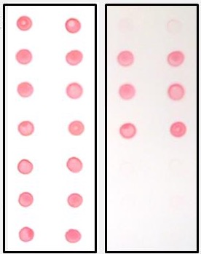
Preeclampsia – Urine Congophilia
before
after
Urine
Severe PE
OD after
%CRR =
x100
OD before
Normal
pregnancy
Congo Red Dot Test
(nitrocellulose sheet)
Buhimschi IA, Buhimschi CS, Glabe CG. Methods and compositions for the detection and treatment of preeclampsia. U.S. Patent 9,229,009. Filed October 31, 2008 (Yale University); Issued January 5, 2016.

Slide 13
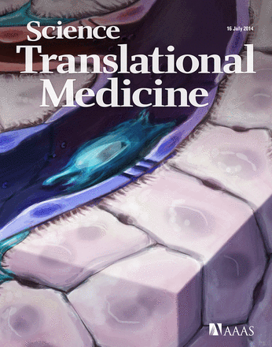
Urine Congophilia – PE biomarker
662 women:
Feasibility (n=80); Validation - cross-sectional (526); Longitudinal (n=56)
Buhimschi IA, Nayeri UA, Shook LL, Pensalfini A, Funai EF, Bernstein IM, Glabe CG, Buhimschi CS. Protein misfolding, congophilia, oligomerization and defective amyloid processing in preeclampsia. Sci Transl Med. 2014;

Slide 14
Urine Congophilia – PE Biomarker
Validation samples
Sens, Spec, PPV, NPV; 86%, 85%, 83%, 87%; Reference: medically indicated delivery for PE
Buhimschi IA, Nayeri UA, Shook LL, Pensalfini A, Funai EF, Bernstein IM, Glabe CG, Buhimschi CS. Protein misfolding, congophilia, oligomerization and defective amyloid processing in preeclampsia. Sci Transl Med. 2014;

Slide 15
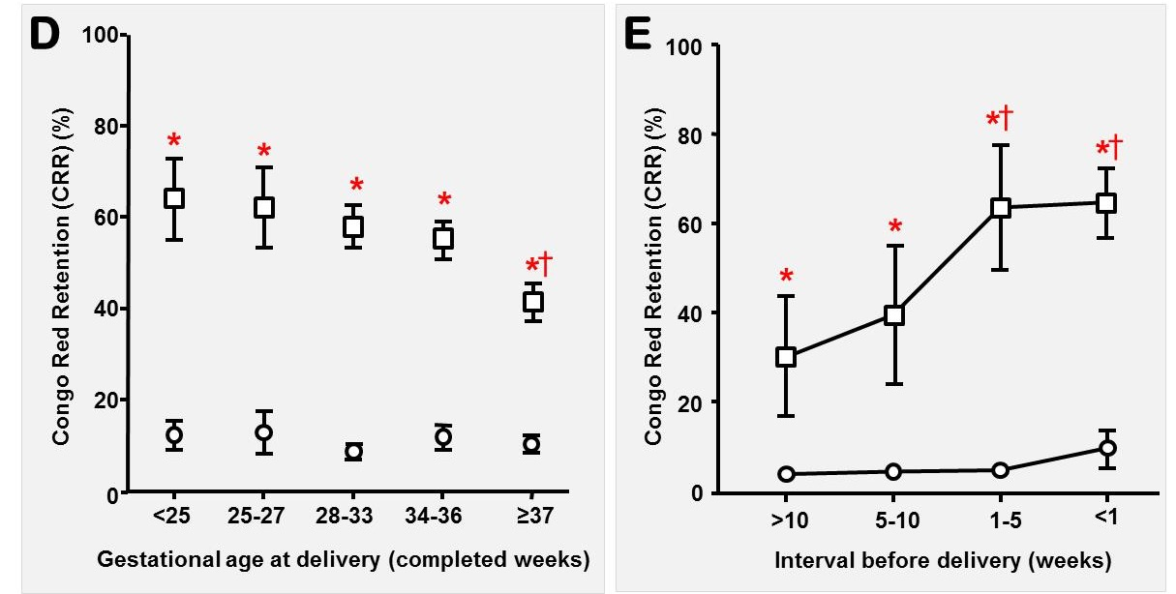
Urine Congophilia – PE biomarker
Validation samples
Cross-sectional
Longitudinal
Buhimschi IA, Nayeri UA, Shook LL, Pensalfini A, Funai EF, Bernstein IM, Glabe CG, Buhimschi CS. Protein misfolding, congophilia, oligomerization and defective amyloid processing in preeclampsia. Sci Transl Med. 2014;

Slide 16
Urine Congophilia ≠ Proteinuria
Urine congophilia correlates with 24h proteinuria but is not the same biomarker
MIDPE: Medically-indicated delivery for preeclampsia

Slide 17
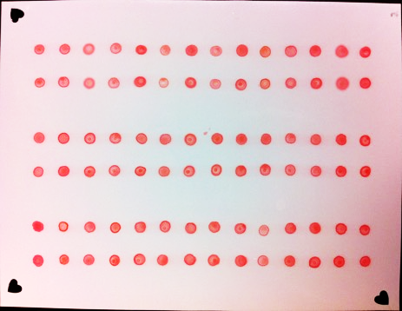
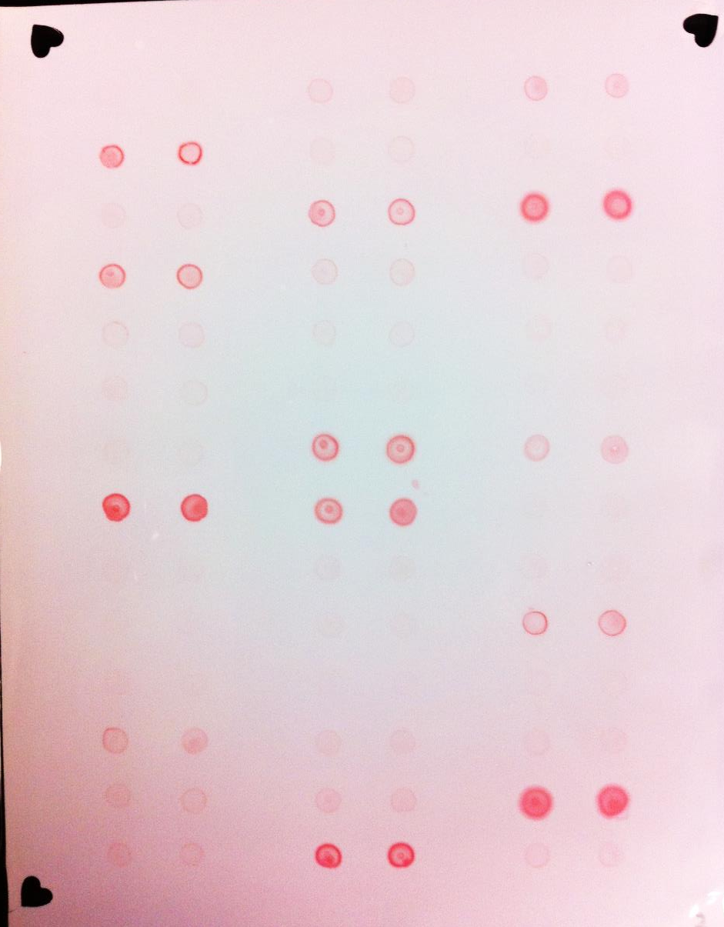
Urine Congophilia – Automation
Array (batch) direct format : congophilia “gold standard” (nitrocellulose = inert surface )
pix1: before
pix2: after
%CRR: 0-100
Jonas SM, Deserno TM Buhimschi CS, Makin J. Choma MA. Buhimschi IA. Smartphone-based diagnostic for preeclampsia: an mHealth solution for administering the Congo Red Dot (CRD) test in settings with limited resources. J Am Med Inform Assoc. 2015

Slide 18
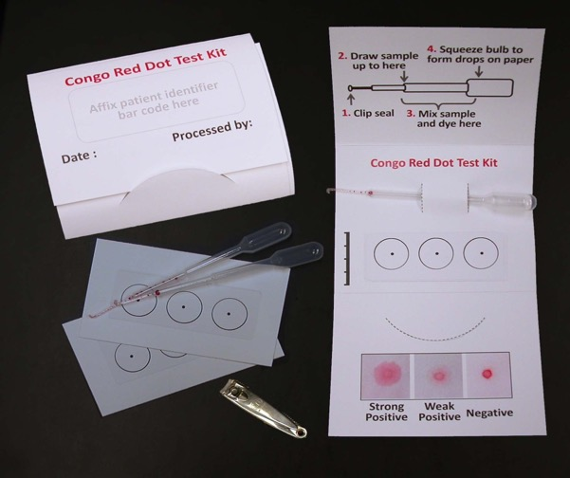
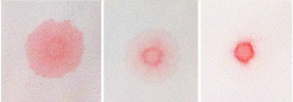
Urine Congophilia – Point of Care
“Sample-in-result-out” format (no washes)
Paper chromatography & competitive affinity for cellulose
CRD Paper Test
Neg
WP
SP
Not every paper works!
Buhimschi IA, Buhimschi CS, Tagare H, Choma M, Jonas S. Methods and kits for detecting misfolded proteins. U.S. Patent Number 10,048,276 Filed April 1, 2015 (Yale University) issued August 14, 2018.

Slide 19
Urine Congophilia – POC α prototype
Validation Study in antenatal triage (Ohio): 346 prospectively enrolled women
(rule-out preeclampsia) (2019)
Real life (unselected) cohort: any gestational age, multiples, any co-morbidity
Clinically trained research nurses ran the test POC
Reference: adjudicated diagnosis of preeclampsia
Sens, Spec, PPV, NPV; 80%, 89%, 74%, 92%
Rood KM, Buhimschi CS, Dible T, Webster S, Zhao G, Samuels P, Buhimschi IA. Congo Red Dot Paper Test for Antenatal Triage and Rapid Identification of Preeclampsia. EClinicalMedicine. 2019 Mar 1;8:47-56. doi: 10.1016/j.eclinm.2019.02.004.

Slide 20
Outlier Analysis
Clinical Outcome * | Adjudicated Diagnosis | Positive CRD Test Result | Case Notes
NO MIDPE n = 212 | NO PE n = 201 | NO, n = 181 True negative | Unanimous concordance ruling out PE
 |  | YES, n = 20 False positive | Cases in this category were medically indicated deliveries due to worsening chronic nephropathy, worsening crHTN or gestHT without a call of PE or spPE
 | YES PE n = 11 | NO, n = 3 False negative | Case adjudication was of PE w/o severe features or crHTN with spPE. All 3 cases were managed expectantly and all had medically indicated preterm deliveries for NRFHR or PPROM
 |  | YES, n = 8 True positive | CRD concurred with the adjudicated diagnosis. All these cases were admitted following initial evaluation in triage (7 with a PE dg and 1 with uncertain PE status). Delivery indications were for all preterm for NRFHR or PPROM
YES MIDPE n = 121 | NO PE n = 36 | NO, n = 33 True negative | CRD concurred with the adjudicated diagnosis. Most MIDPE indications were in context of non-specific headache and the majority were near-term or at term
 |  | YES, n = 3 False positive | Case adjudication was crHTN while the managing team's call was PE w/o severe features or spPE
 | YES PE n = 85 | NO, n = 16 False negative | Delivery indications and adjudication concurred as PE w/o severe features, spPE in the context of crHTN or HELLP syndrome features absent hypertension or proteinuria
 |  | YES, n = 69 True positive | Unanimous concordance confirming PE
Problem is in the definition and classification of HDP & PE !

Slide 21
Studies by Others
Research lab direct format (nitrocellulose)
McCarthy FP, Adetoba A, Gill C, et al. Urinary congophilia in women with hypertensive disorders of pregnancy and preexisting proteinuria or hypertension. Am J Obstet Gynecol 2016; 215: 464.e1–7.
Sammar M, Syngelaki A, Sharabi-Nov A, Nicolaides K, Meiri H. Can Staining of Damaged Proteins in Urine Effectively Predict Preeclampsia? Fetal Diagn Ther 2017; 41: 23–31.
Nagarajappa C, Rangappa SS, Suryanarayana R, Balakrishna S. Urinary congophilia in preeclampsia: Experience from a rural tertiary-care hospital in India. Pregnancy Hypertension 2018; 13: 83–86.
*****************************************
CONCLUSIONS (Nagarajappa): This study confirms the presence of urinary congophilia in Indian pregnant women with preeclampsia. Furthermore, our study shows that urinary congophilia is not affected by clinical variables like gestational age of onset, severity, superimposition by eclampsia and complication by intrauterine growth restriction and intrauterine death. Urinary congophilia can be used to differentially identify preeclamptic pregnant women from normotensive pregnant women.

Slide 22
Urine Congophilia – POC β prototype
Problem is in the definition and classification of HDP & PE !
PE in Mexico = PE in Bangladesh
Congophilia in Mexico = Congophilia in Bangladesh
Bracken H, Buhimschi IA, Rahman A, Smith PRS, Pervin J, Rouf S, Bousieguez M, López LG, Buhimschi CS, Easterling T, Winikoff B. Congo red test for identification of preeclampsia: Results of a prospective diagnostic case-control study in Bangladesh and Mexico. EClinicalMedicine. 2020 Dec 22;31:100678. doi: 10.1016/j.eclinm.2020.100678.

Slide 23
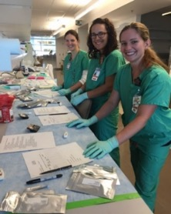
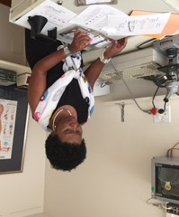
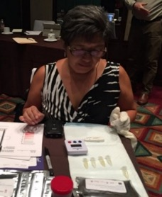
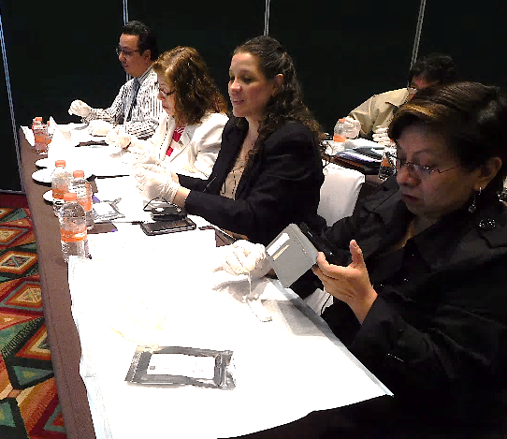
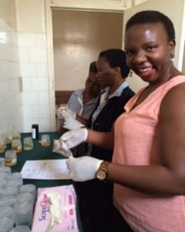
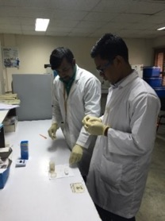
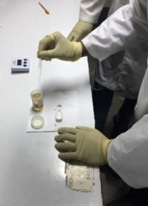
Next Steps
Licensed by Yale University for further development
Operational Feasibility Study in Ethiopia and Uganda supported by Grand Challenges Canada
HELP ALONG THE WAY:

Slide 24
PART II
Operational Feasibility Study
Diagnosing Preeclampsia Based on Urine Congophilia (Biomarker) at Different Health Care Levels in Ethiopia and Uganda
supported by Grand Challenges Canada

Slide 25
Overview
Key Questions:
1) Can the Congo Red Test be used successfully at lower levels of care in LMIC?
2) What is the prevalence of urine congophilia at ANC vs. referral care levels
3) What are the characteristics of patients, providers and health care facilities?
Rationale for Congo Red Test: practical feasibility for Antenatal Care (ANC) in LMIC
9 month study period (Jan – September 2021)
Funding support from Grand Challenges Canada

Slide 26
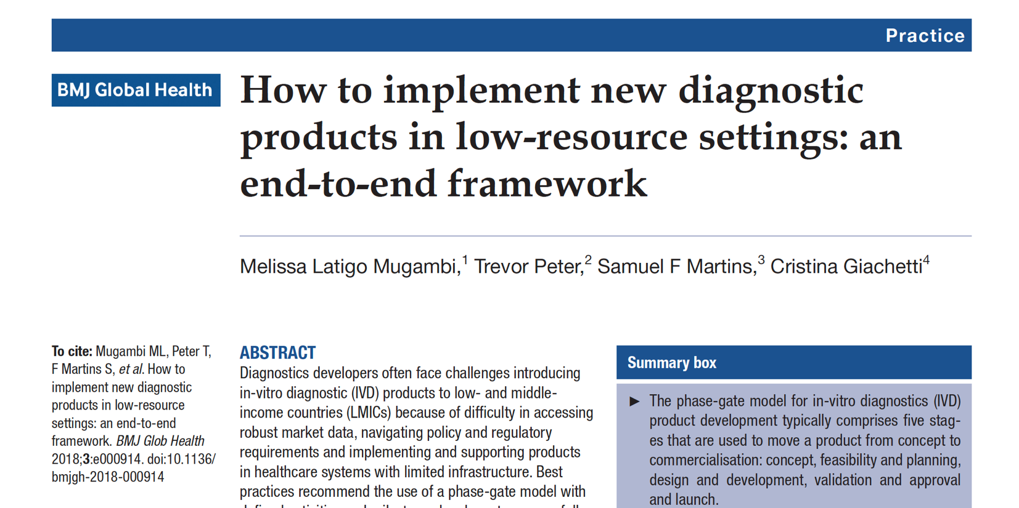
Conceptual Framework

Slide 27
Conceptual Framework (cont)
 | Phase 0 | Phase 1 | Phase 2 | Phase 3 | Phase 4
 | Concept | Feasibility | Design | Validation | Post-launch
R&D, Legal | Select technologies Establish proof of concept | Demonstrate technical feasibility Prepare R&D, clinical, regulatory plans Risk assessment IP | Optimize prototype Verification studies Manufacturing and quality control plan | Clinical validation studies Register product | Scale-up manufacturing, supply chains, coverage
Policy | Initial communication with policymakers, procurers and donors | Engage key stakeholders | Align product offering with policy, procurement and funding guidelines | Register with WHO | Ensure product continues to stays in country guidelines
Marketing & Sales | Market research Work with R&D to create product concept(s) Business case and financial model | Finalize user requirements Develop marketing and sales plan Develop global access plan | Update marketing, global access, business case, etc. | Execute marketing and sales plan | Customer support, training and QA Growth
Mugambi ML, Peter T, F Martins S, et al. How to implement new diagnostic products in low-resource settings: an end-to-end framework. BMJ Glob Health 2018;3:e000914. doi:10.1136/ bmjgh-2018-000914 (abbreviated and modified for this presentation)

Slide 28
Study Objectives
Prevalence of urine congophilia among patients presenting for ANC and/or rule-out of suspected preeclampsia
Feasibility and acceptability to perform and interpret the CRD test (GV-010)
Map care practices and referral patterns for the management of patients with suspected preeclampsia
Understand patients’ baseline knowledge and health literacy related to preeclampsia

Slide 29
Team
PIs:
Dr. Irina Buhimschi
Dr. Gelila Goba
Country PIs:
Dr. Delayehu Bekele, ESOG
Dr. Sam Ononge, Makerere University
Other Team Leads:
Jill Durocher, Gynuity
Wendy Davis, GestVision

Slide 30
Methodology
Matched Case-Control (ANC) + Cases (Referral) study
Knowledge of Preeclampsia (patients)
Health Facility Survey
Provider interviews
Market Analysis
Blinding:
Research staff are are blinded to patient condition.
Adjudicators are blinded to the CRD result.
Adjudicators have access to episode of care and outcome data

Slide 31
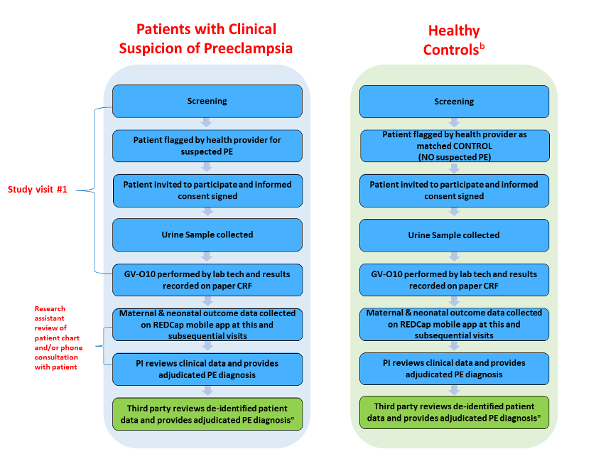
Methodology (cont)
TWO-GATE, MATCHED CASES
PRIMARY ANC
SINGLE GATE
REFERRAL CENTERS

Slide 32
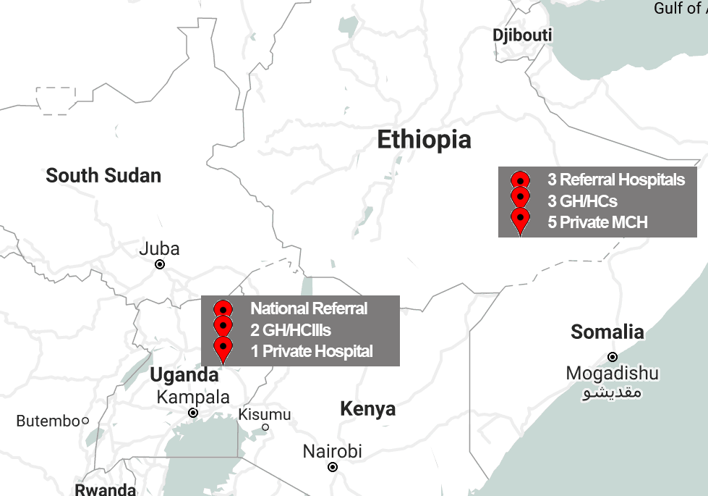
Sites
Ethiopia (n=3,870)
Lead Partner: ESOG
3 Referral Hospitals
3 GH/HC Clusters
5 Private MCH Centers
Uganda (n=1,300)
Lead Partner: Mak U
National Referral Hospital
2 Hospitals + HCIIIs
Lifeline Hospital (Kampala)

Slide 33
Implications
Integration into Standard of Care in Ethiopia and Uganda?
Integration into other African/LMIC settings?
Can every pregnancy globally be supported by Congo Red test?
No maternal deaths or severe morbidity from preeclampsia / eclampsia
PE/E

